Slide 1



Week3-Zirimwabago-bahati-individual-project
View in Power BI
Last data refresh:
11/21/2022 8:35:29 AM UTC
Downloaded at:
1/24/2023 8:19:56 PM UTC

Slide 2
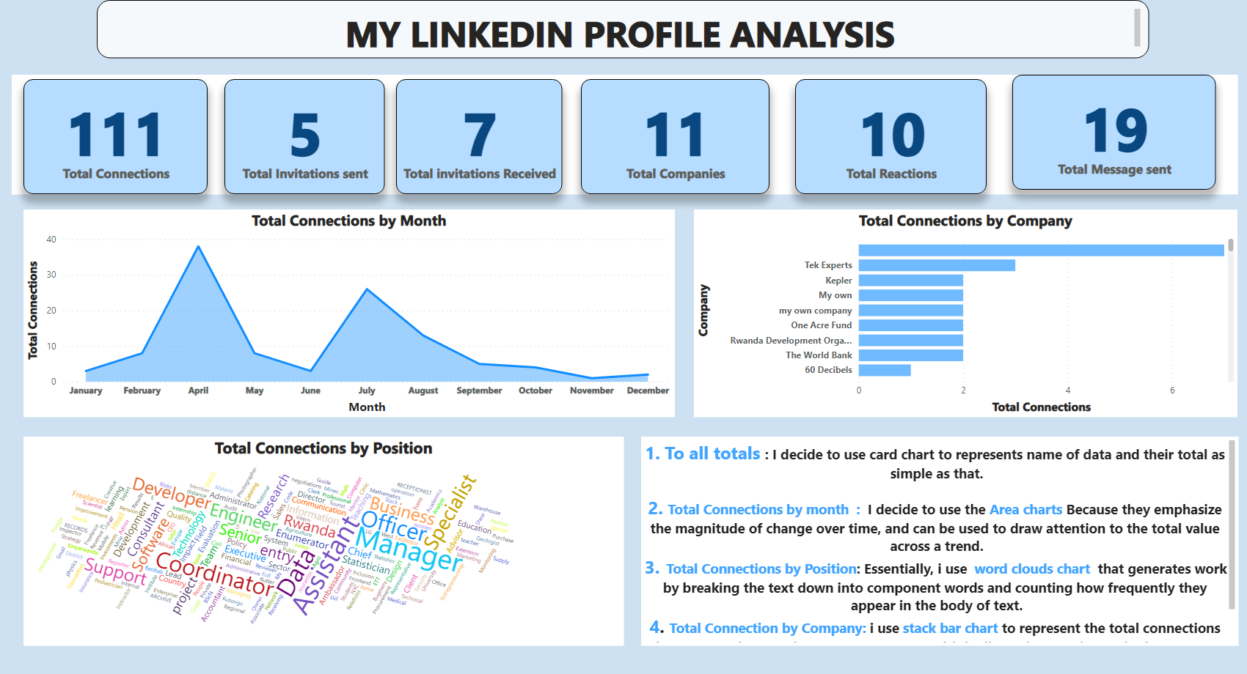
Page 1
Notes:
textbox
No alt text provided
textbox
No alt text provided
textbox
No alt text provided
WordCloud1447959067750
No alt text provided
card
No alt text provided
card
No alt text provided
card
No alt text provided
card
No alt text provided
card
No alt text provided
card
No alt text provided
areaChart
No alt text provided
barChart
No alt text provided

